Slide 1

Command Line Options
Dr. Ball

Slide 2
Command Line Options
Allow a program/script to be customized
Sends data to the program/script
Tells the program/script what to do or how to do it
Provides options for how the program/script is run
Options can allow arguments to be passed from the command line

Slide 3
The optparse Module
Provides a convenient way to define script options
Reads options from the command line
Can be an alternative to asking for user input

Slide 4
optparse example
import optparse
parser = optparse.OptionParser()
parser.add_option("-n", "--name", default = "world", dest="name", help="Say hello to NAME", metavar = "NAME")
(options, args) = parser.parse_args()
print(f"Hello, {options.name}!")

Slide 5
Usage Explanation
-n is the short option
--name is the long option
default is the value used if not option is specified
dest is the variable where the information will be stored
help provides information about how to use the command
metavar is used in documentation

Slide 6
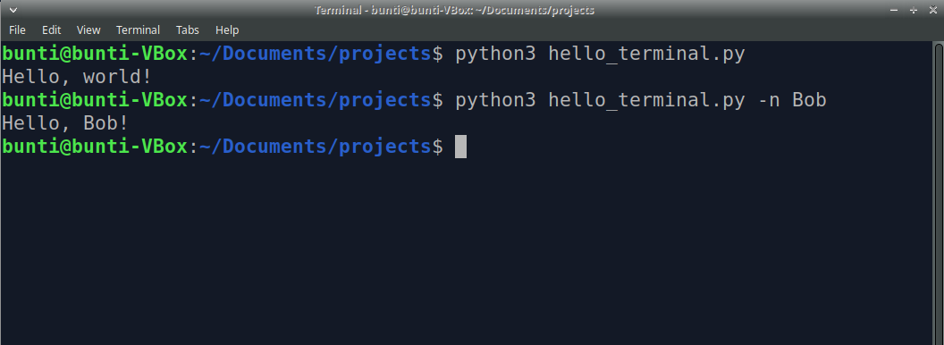
Usage Example

Slide 7
Other "Options"
action
store (default)
store_true
store_false
type
string (default)
int
float
Usage
action='store', type='int', dest='num'
action='store_true', dest='verbose'
action='store', type='string', dest='name'

Slide 8
Another Example
import optparse
parser = optparse.OptionParser()
parser.add_option("-n", "--name", default="world", dest="name", help="Say hello to NAME", metavar="NAME")
parser.add_option("-v", "--verbose", default=False, action="store_true", dest="verbose", help="Turn on verbosity", metavar="VERBOSE")
(options, args) = parser.parse_args()
if options.verbose:
print("This program will say hello to someone or to the whole world.")
print(f"Hello, {options.name}!")

Slide 9
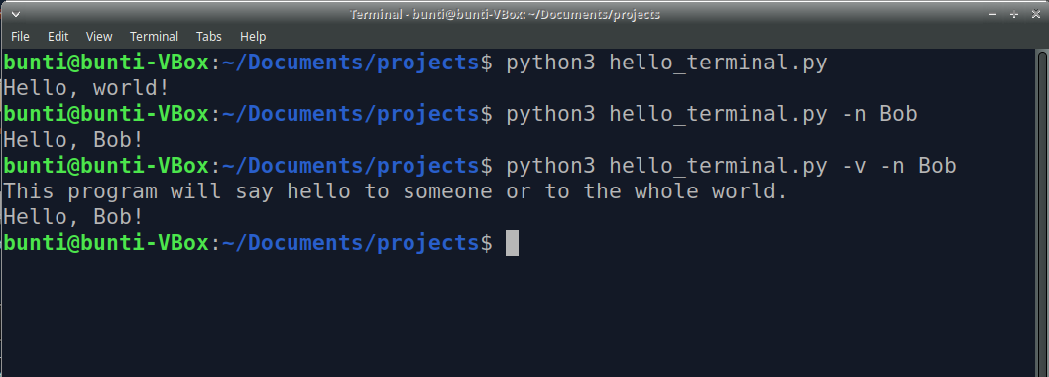
Usage Example

Slide 10
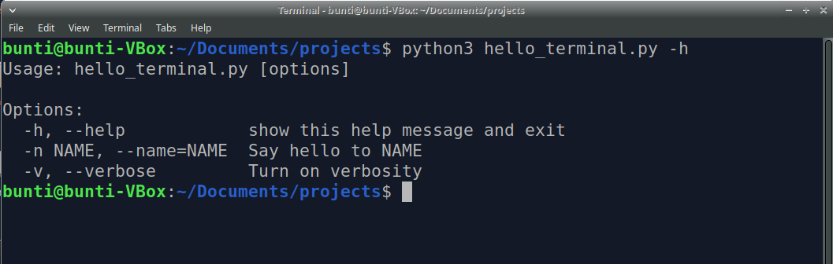
Help!
Use -h or --help to display the help information
You can also display this message by using parser.print_help()

Slide 12

Check on Learning

Slide 13
Closing Comments

Slide 14
Questions & Comments

